Slide 1




Creating Safe Spaces Online
Implementing Models to Censor Differing Opinions on Social Networks

Slide 2
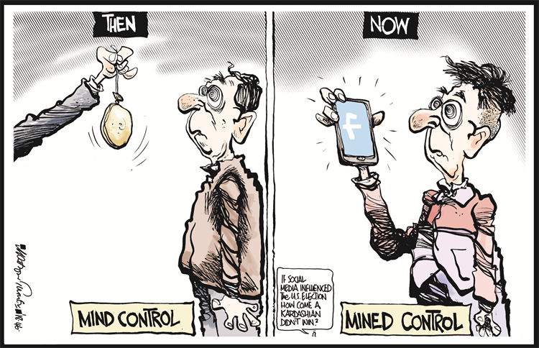
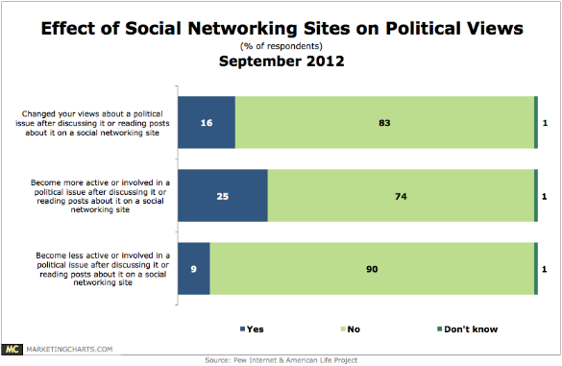
Social Media influences the way people view politics

Slide 3
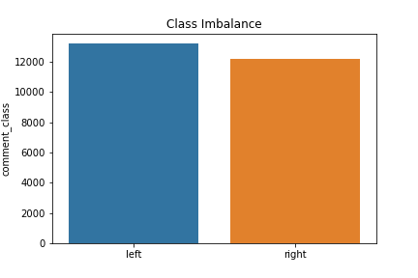
Project Summary
Data
Reddit: comments from polarized, political subreddits
180k+ comments (before filtering)
13k ‘left leaning’ (after filtering)
12k ‘right leaning’ (after filtering)
Target Variable: ‘political leanings’ (right vs left)
Objectives
Build predictive classification model to optimize identification of political leanings
Implement better censorship of polarized political subreddits to assist online moderators
Optimize accuracy as primary classification metric

Slide 4
The Process
EDA
Collection / Cleaning
Feature Engineering
Feature Selection
Model Building
Dataset appended from Reddit API every morning
Data cleaning and preprocessing
Explored target variable ‘comment_class’
Identified predictor variables with greatest impact on political leanings
Generate ideas for feature engineering
Domain knowledge combined with EDA
Hypothesis testing to determine value
NLP built-in Feature Engineering
word2vec
Iterated through combinations of engineered features
KMeans
RFC
SVM
MN Bayes

Slide 5
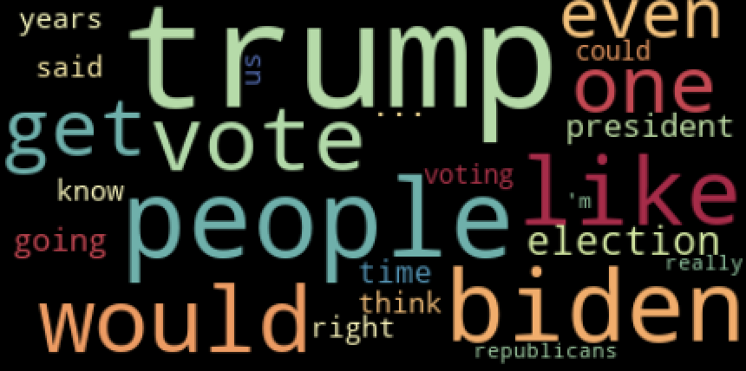
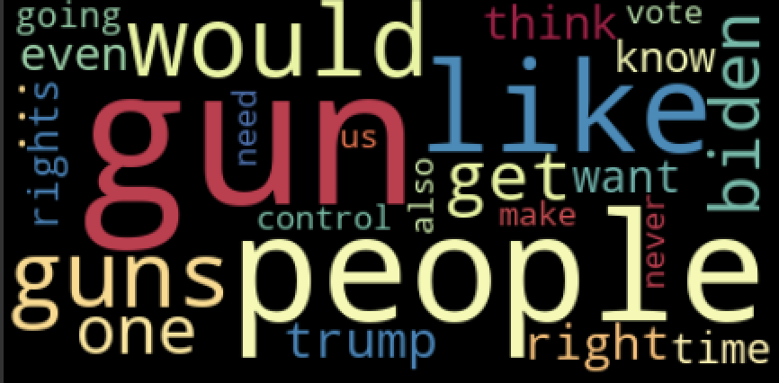
Buzzwords: One is not like the other
There is a difference between main words / topics in polarized subreddits
Notes of Interest:
‘’trump’
‘gun’
‘people’
Features we tested:
POS Tags
Profanity
Lexical Diversity
Stop Words
Etc…
Left
Right

Slide 6
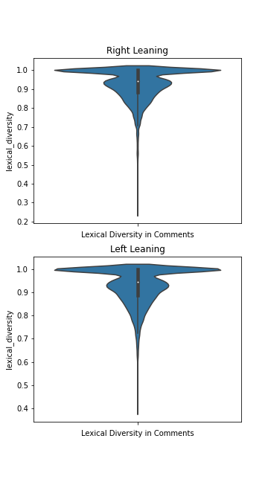
EDA – Lexical Div.
Tested to see if there is a difference based on diversity of comment language
Lexical Diversity = (unique words) / (total words) per comment
Based on our analysis, :
Based on image, no noticeable difference
Ttest confirms there is a statistically significant difference (p = .0002)

Slide 7
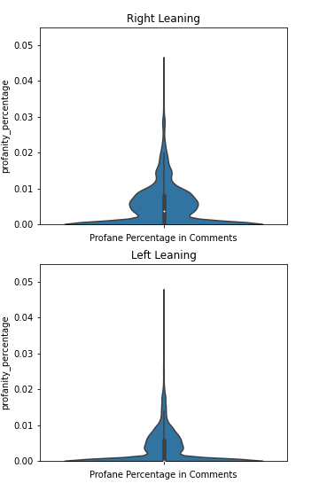
EDA – Profanity
Obtained list of 1,300+ ‘offensive’ English terms
Calculated % ‘offensive’ words per comment, analyzed by political leanings
Based on our analysis, :
There is a statistically significant difference (p = 2.007e-139)
Commenters on the Right tend to use more profanity

Slide 8
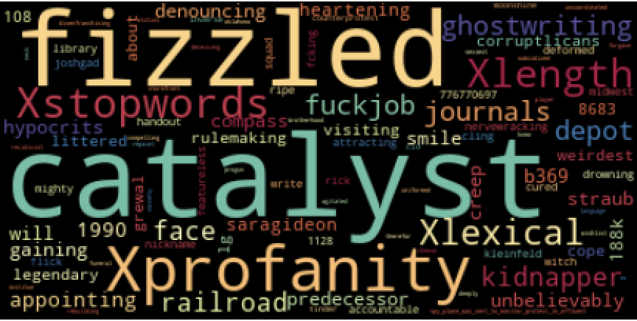
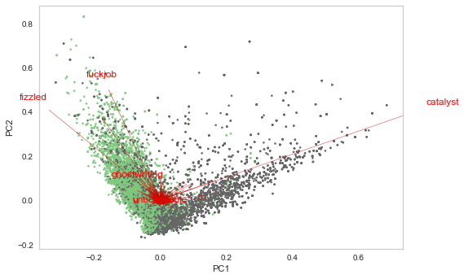
95% Accuracy: Random Forest + tFIDF + Top Custom Features
Features Importance
PCA Biplot
Disclaimer: first two PCA components account for only 1% of variance. Still, it is interesting to see the same features appear as important that we saw in RFC

Slide 9
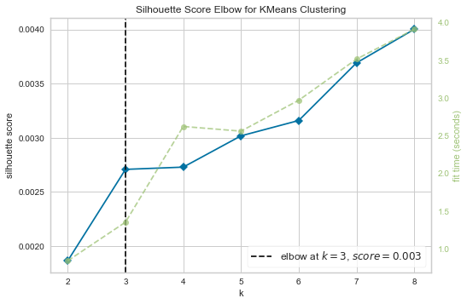
Major Next Steps: Introduce New Classes (Centrist)
We believe there are more than 2 clusters

Slide 10
Misclassification Analysis
Guessed Right, was Left
In my 8th grade class there was a class you could choose to take and part of it they taught us about GUNS. At the end of the FIREARM segment we got to go to a range and SHOOT .22s It was a very FUN class.
Guessed Left, was Right
I live in a complete red zone. I'm the only one I know that DOESN’T WORSHIP TRUMP. It can be a bit much to process at times....so I feel your pain.

Slide 11
THANK YOU

